Slide 1
Grid Network Experiments 2
Feng Yuzhen
2021/9/29

Slide 2
Pre-experiment Parameters
Grid network size: 180 * 180
Number of ODs: 2000
Pick-up time: 1s
Maximum detour distance: 5m
Search Radius: 5m
Speed: 1m/s

Slide 3
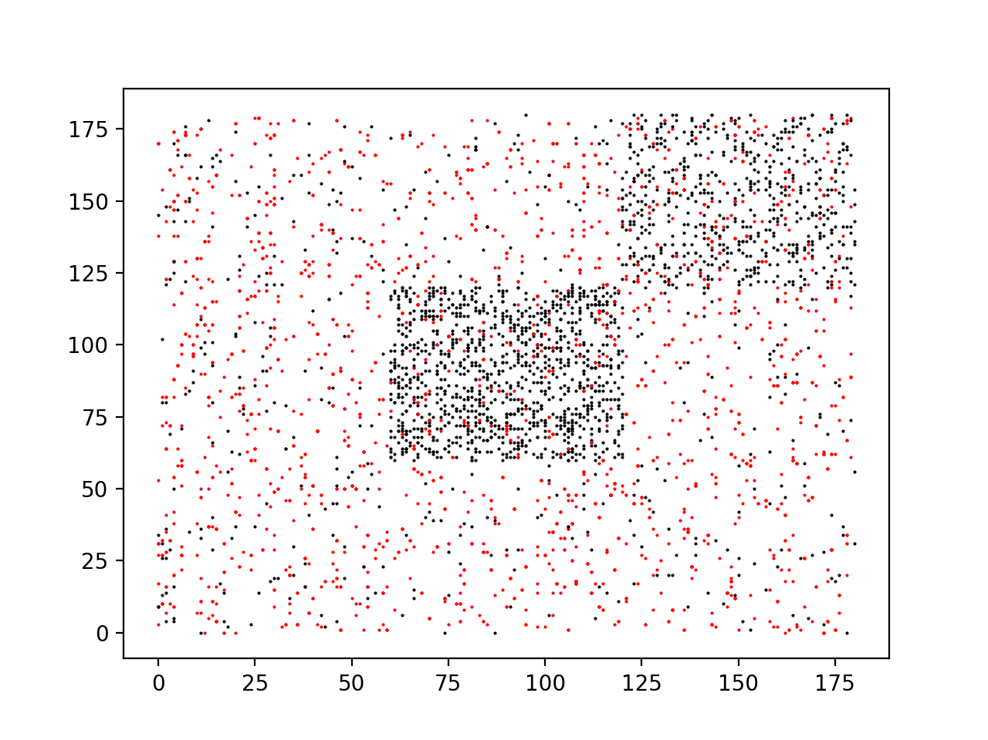

Pre-experiment Results
Time of step 0: 127.653s
Time of step 1: 3.200s
Number of iterations: 14 (with absolute error $ε=0.01$)

Slide 4
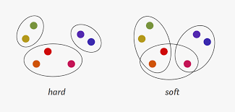
Type of Clustering
Broadly speaking, clustering can be divided into two subgroups:
Hard Clustering: In hard clustering, each data point either belongs to a cluster completely or not.
Soft Clustering: In soft clustering, instead of putting each data point into a separate cluster, a probability or likelihood of that data point to be in those clusters is assigned.

